Slide 1
Tutorial: Using PSP1
Personal Software Process
for Engineers: Part I

Slide 2


Slide 3
Tutorial Objectives
After this tutorial, you will
  understand the new elements of PSP1
  know how to use the PSP1 process scripts and forms
  be prepared to use PSP1 for program 3

Slide 4
PSP1 Objective
The objective of PSP1 is to establish an orderly and repeatable procedure for developing software size estimates.

Slide 5
New Process Elements
The new process elements are:
  PROBE size estimating method and size estimating template
  test report template
The project plan summary has been expanded.
  Summary section has been added with plan, actual, and to-date productivity
  Program Size summary includes planned size for all size accounting types
  All values except the Total Size under Actual in the Program Size Summary are now calculated.

Slide 6
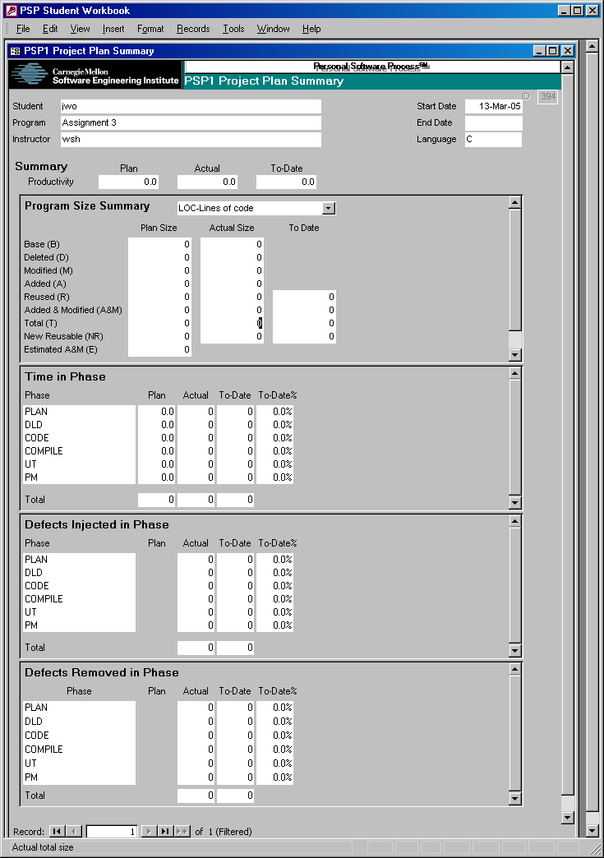
PSP1 Project Plan Summary -1
The PSP1 Project Plan Summary includes a new summary section.
The summary section includes plan, actual, and to-date productivity.
The program size summary section has been expanded to report planned size for all size accounting types.
All values except total actual size are calculated.

Slide 7
PSP1 Project Plan Summary -2
Plan, actual, and to-date productivity is automatically calculated.
It is the number of added and modified size units per hour.
Productivity = A&M Size / Total Development Time * 60

Slide 8
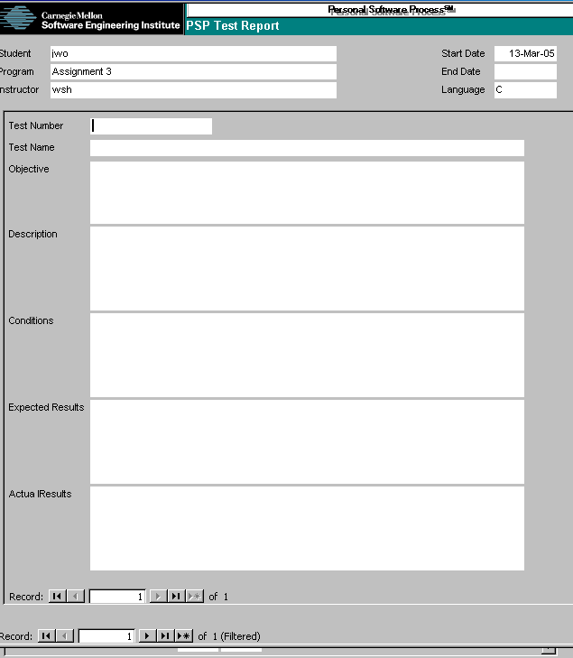
Test Report Template
Use this form to record data on each of your tests.
  what test was run
  which test data were used
  results that were obtained
Helpful for
  developing and recording
  test cases
  performing regression testing

Slide 9
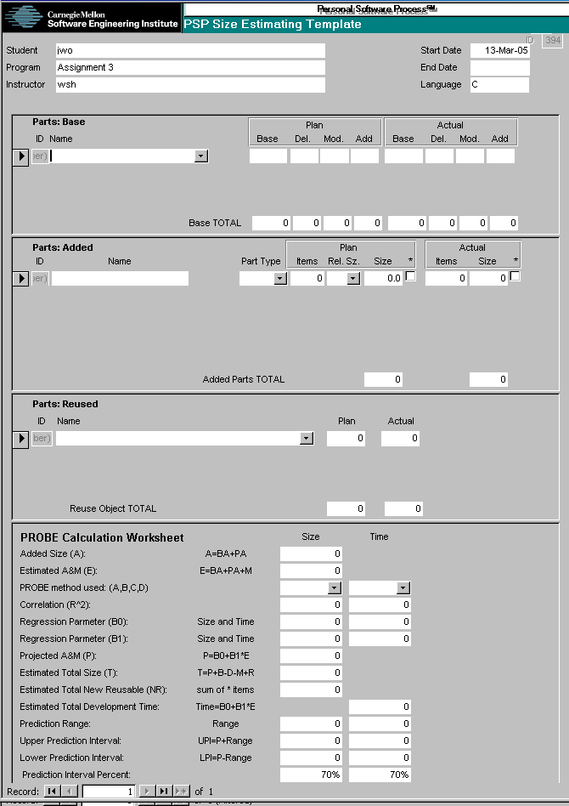
PROBE and the Size Estimating Template
Starting with PSP1, the PROBE method is used for making size and time estimates.
The Size Estimating Template is used to
  record input to the PROBE method
  calculate the estimated size and time
  record actual size

Slide 10
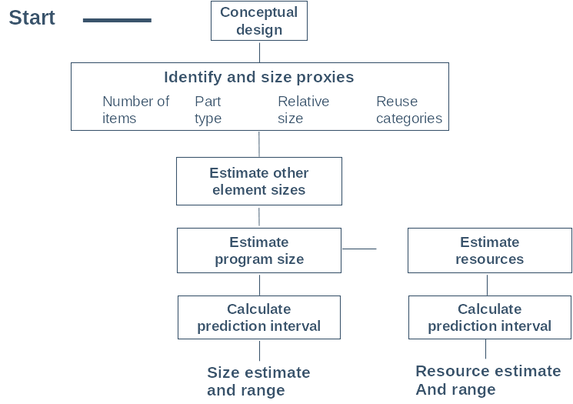
Steps in the PROBE Method
Notes:
Describe the steps in the PROBE method

Slide 11
Conceptual Design
Conceptual design relates the requirements to the parts needed to produce the program.
The parts needed are
  base parts – an existing part that can be used but will require modifications.
  added parts – new parts that need to be developed.
  reused parts – an existing part that can be used as-is.

Slide 12
Identify and Size Proxies
Added parts are new parts that must be developed and their size must be estimated.
The size of an added part is determined by using a proxy.
  Identify the part type, e.g. calculation, IO, etc.
  Estimate the number of items, e.g. methods.
  Estimate the relative size, i.e. very small, small, medium, large, or very large.
  Find the size of an item of this part type and relative size in the relative size table.
  Calculate the estimated size = size of an item * number of items

Slide 13
Estimate Other Element Sizes
Base parts are existing parts that will be changed by adding, deleting, or modifying.
The size estimate of a base part is its actual size and an estimate of the additions, deletions, and modifications.
Reused parts are parts that are used without modification.
The size estimate of a reused part is its actual size.

Slide 14
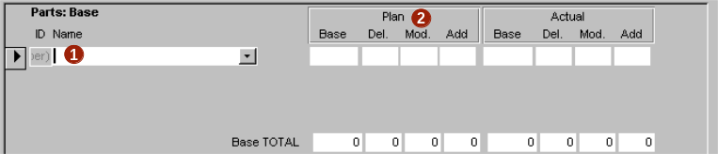
Estimating Base Parts
During planning, enter each base part
  Enter the name of the base part or use the combo box to select a part from the parts library.
  Enter the planned size of the base part
    Enter the base size if the part was not selected from the parts library
    Enter the estimated deleted, modified, and added size.

Slide 15
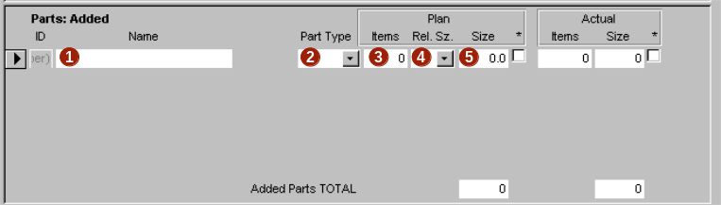
Estimating Added Parts
During planning, enter each added part
  Enter the part name.
  Select a part type.
  Enter the planned number of items.
  Enter the planned relative size.
  Planned size is automatically calculated.

Slide 16
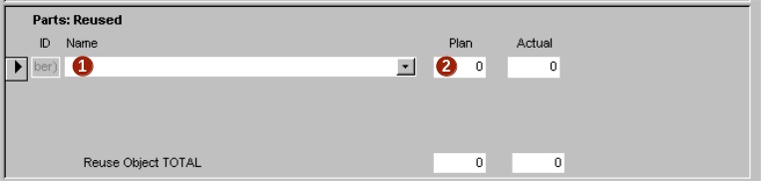
Estimating Reused Parts
During planning, enter each reused part
  Enter the name of the reuse part or use the combo box to select a part from the parts library.
  Enter the planned size of the reuse part if the part was not selected from the parts library.

Slide 17
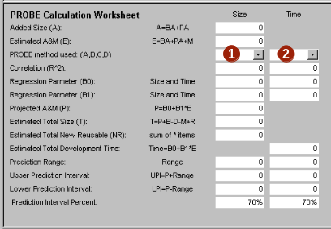
Estimate Projected Size and Time
Projected size and time are calculated from estimated part size using historical data and PROBE method A, B, C, or D.
The PROBE Calculation Worksheet automates these calculations.
During planning, select a
PROBE method
  Select a method for program size (A, B, C, or D)
  Select a method for time
  (A, B, C, or D)

Slide 18
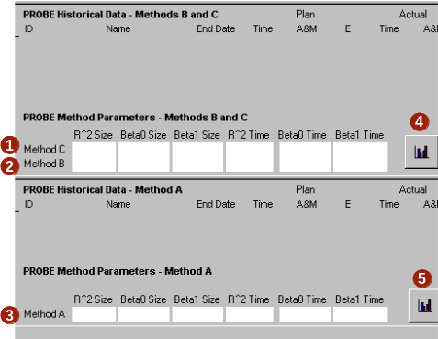
Selecting PROBE Methods
The PROBE script includes guidelines for selecting methods.
The parameters referenced in the script can be found at the bottom of the size estimating template.
Method selection data
  method C
  method B
  method A
Method data can be graphed
  method C and B
  method A

Slide 19
Estimates Transferred to Plan Summary
Estimates are automatically transferred to the Plan Summary

Slide 20
After Development
During postmortem the actual size of parts is entered on the size estimating template.
The actual size of the program is entered in Total, under Actual, in
the Program Size Summary section of the project plan summary.

Slide 21
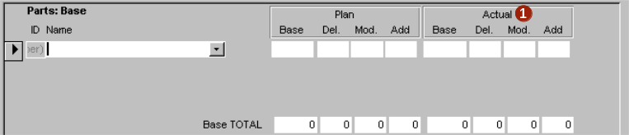
Recording Base Part Size
During postmortem, enter the size of each base part
  Measure and enter the actual base, deleted, modified,
  and added size.
Note:
  For a part not estimated, add it and enter zeros in plan.
  For a part not used, enter zeros in actual.

Slide 22
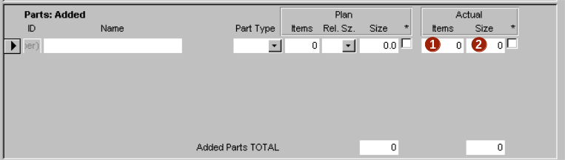
Recording Added Part Size
During postmortem, enter the size of each added part.
  Measure and enter the actual number of items.
  Measure and enter the actual size.
Note:
  For a part not estimated, add it and enter zeros in plan,
  For a part not used, enter zeros in actual.

Slide 23
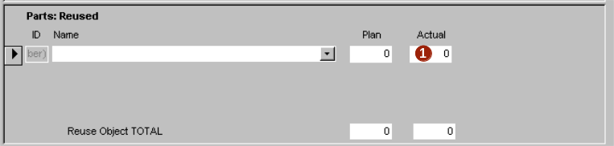
Recording Reused Part Size
During postmortem, enter the size of each reuse part.
  Measure and enter the actual size of the reuse part.
Note:
  For a part not estimated, add it and enter zeros in plan.
  For a part not used, enter zeros in actual.

Slide 24
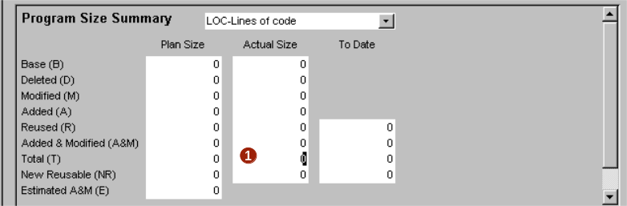
Recording Total Actual Size
During postmortem
  Measure and enter the actual total size.

Slide 25
Messages to Remember
Estimating accuracy will fluctuate.
Your estimates will have some bias.
PROBE adjusts for bias using historical data.
Engineering judgment is still required.

